Slide 1

NPTEL
Applied Accelerated Artificial Intelligence
Instructor: Dr. Satyajit Das
Dept. of Computer Science and Engineering
Indian Institute of Technology Guwahati, Assam, India

Slide 2
Segment 5: AI Software Stack - OS, Drivers & Runtime Layers
The layered software architecture that connects your Python code to silicon transistors

Slide 3
Learning Objectives - Segment 5
01
Map the full AI software stack from user-space frameworks to kernel drivers
02
Explain the role of CUDA Runtime, cuDNN, cuBLAS, and NCCL in the NVIDIA stack
03
Describe GPU driver management, kernel modules, and CUDA version compatibility
04
Understand container runtimes (Docker, containerd) and NVIDIA Container Toolkit
05
Identify the key Linux kernel features leveraged by AI workloads (hugepages, cgroups, IOMMU)

Slide 4
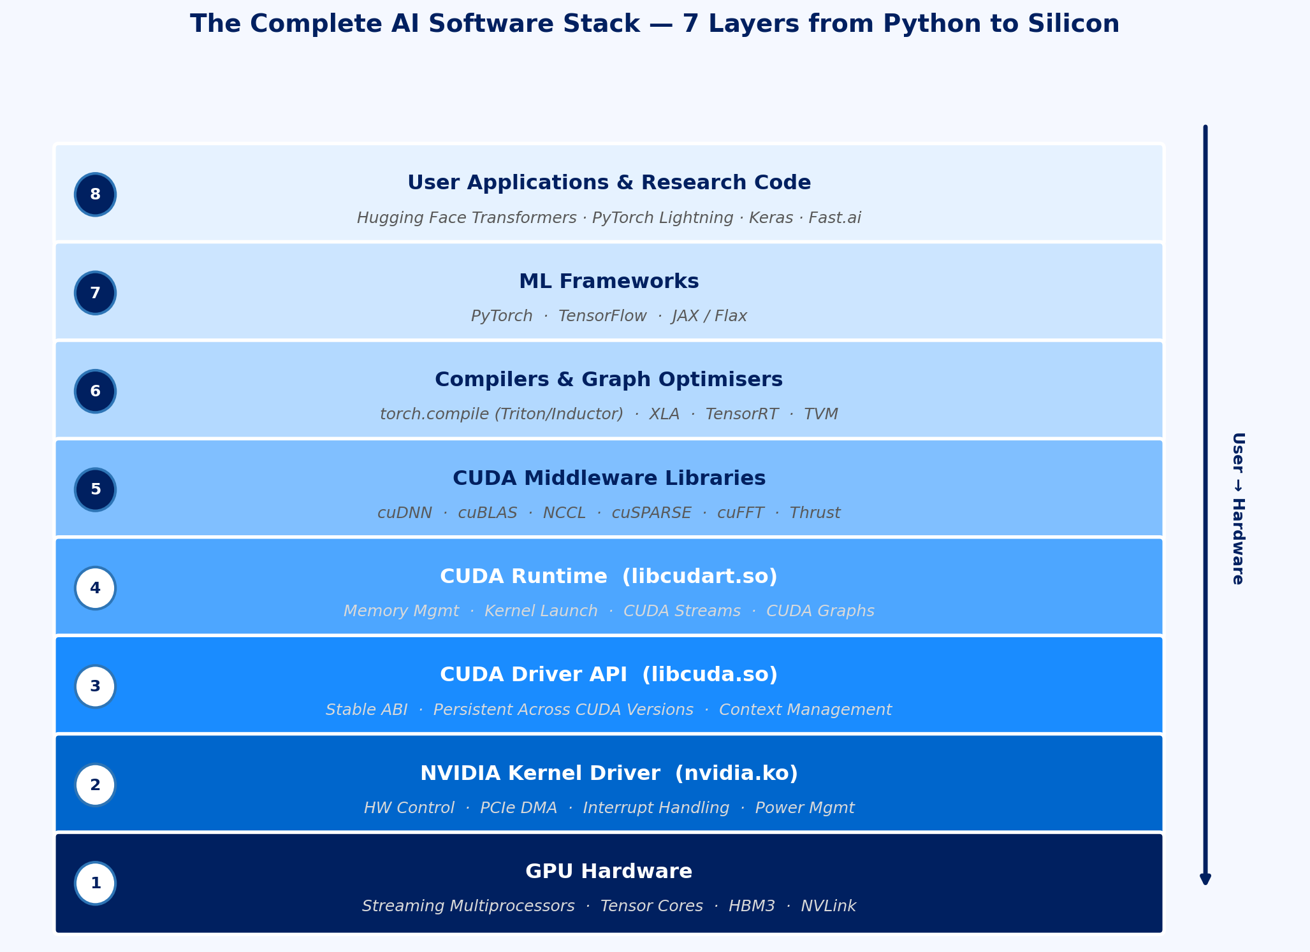
The Full AI Software Stack: Layer by Layer
Fig 13: The Complete AI Software Stack — 7 Layers
Ref: NVIDIA CUDA Programming Guide v12 (2024); CUDA C++ Best Practices Guide

Slide 5
CUDA Runtime, cuDNN, and cuBLAS: Under the Hood
CUDA Runtime: Memory and Execution Management
cudaMalloc / cudaFree: allocate/release GPU global memory (HBM)
cudaMemcpy / cudaMemcpyAsync: host-device transfers (sync/async with streams)
CUDA Streams: logical queues for ordering kernel execution and memory transfers
CUDA Graphs: capture and replay sequences of operations with reduced launch overhead
cuDNN: The Convolution and Attention Engine
Provides conv2d, bn, pooling, activation, dropout, RNN, MHA ops for DL
Heuristic algorithm selection: picks fastest kernel for given tensor shapes and hardware
Flash Attention integrated into cuDNN 8.9+ for memory-efficient attention
cudnnFind: benchmarks all algorithm options - call once, cache result, great for fixed-shape models
cuBLAS: The GEMM Backbone
SGEMM, DGEMM, HGEMM: single/double/half precision matrix-matrix multiply
cublasGemmEx: mixed-precision GEMM with Tensor Core acceleration
PyTorch torch.matmul() ultimately calls cuBLAS GEMM routines internally
CUDA version compatibility: CUDA 12.x requires driver version >= 525.85.12
Check: nvidia-smi shows driver version; nvcc --version shows CUDA toolkit version
Ref: NVIDIA cuDNN Developer Guide v8.9; cuBLAS Library User Guide; CUDA C++ Programming Guide

Slide 6
Linux OS Features for AI Workloads
Huge Pages
Default Linux page: 4 KB; Huge pages: 2 MB or 1 GB per TLB entry
Reduces TLB misses for large ML model weight tensors in CPU RAM
Transparent Huge Pages (THP): kernel auto-promotes pages (often enabled by default)
CUDA allocates GPU memory as large contiguous blocks benefiting from huge pages
cgroups v2 (Control Groups)
Hierarchical resource controller: CPU, memory, I/O, device access
Kubernetes uses cgroups to enforce GPU memory limits and CPU quotas per pod
memory.limit_in_bytes: prevent OOM from propagating across training jobs
IOMMU (Input-Output Memory Management Unit)
Translates device virtual addresses to physical addresses for DMA safety
Intel VT-d / AMD-Vi: required for GPU passthrough in virtualisation (KVM)
GPUDirect requires IOMMU in passthrough mode for peer RDMA
CPU Governor and Power Management
Set CPU governor to ‘performance’: cpupower frequency-set -g performance
Disable CPU C-states for lowest latency: avoids wakeup delay for DataLoader workers
NUMA balancing: disable when NUMA affinity is manually pinned (numactl)
NVIDIA Driver Management
nvidia-smi: monitor GPU utilisation, power, temperature, ECC errors
nvidia-smi -pm 1: enable persistence mode (keep GPU initialised between jobs)
nvidia-smi --auto-boost-default=0: disable boost for reproducible benchmarks
DCGM (Data Centre GPU Manager): health checks, profiling, field injection for testing
System Configuration Checklist
1. Set performance governor & disable C-states
2. Enable hugepages (vm.nr_hugepages=1024)
3. Set GPU persistence mode (nvidia-smi -pm 1)
4. Verify NVLink topology (nvidia-smi topo -m)
Ref: Red Hat Enterprise Linux Performance Tuning Guide; NVIDIA DCGM Documentation (2023)

Slide 7
Container Runtimes and the NVIDIA Container Toolkit
Why Containers for AI?
Reproducible environments: exact CUDA, cuDNN, Python, framework versions pinned in image
Isolation: multiple research groups share the same hardware without conflicts
Portability: same container runs on local DGX, cloud A100, or CI/CD pipeline
NVIDIA Container Toolkit (nvidia-container-toolkit)
OCI hook: intercepts container creation, injects GPU device files and driver libraries
Mounts /dev/nvidia* devices, libcuda.so, and GPU management daemons into container
docker run --gpus all: exposes all GPUs; --gpus ‘device=0,1’ for specific GPUs
No need to install CUDA inside container - driver on host + CUDA runtime in image
NGC (NVIDIA GPU Cloud) Container Registry
Pre-built, optimised containers: PyTorch, TensorFlow, TensorRT, Triton
https://catalog.ngc.nvidia.com/
Always prefer NGC containers for production: includes FlashAttention, TransformerEngine pre-installed
Container Runtime Overhead
Docker/Podman overhead: <1% for GPU compute workloads (host drivers pass through)
Startup time: container import may take 10-30 s for large NGC images (>20 GB)
Volume mounts: always mount datasets as volumes (-v /data:/workspace/data), not inside image
Next week: We will build and run GPU-enabled containers end-to-end
Ref: NVIDIA Container Toolkit Documentation; NGC Catalog at catalog.ngc.nvidia.com

Slide 8
Segment 5 Summary: AI Software Stack
The AI software stack has 7 layers: frameworks → compilers → cuDNN/cuBLAS → CUDA Runtime → Driver → Kernel → Hardware
cuDNN provides conv/attention primitives; cuBLAS provides GEMM - PyTorch calls both transparently
CUDA Streams enable async data transfer + kernel execution overlap; CUDA Graphs reduce kernel launch overhead
Linux performance tuning (hugepages, cgroups, CPU governor, IOMMU) is prerequisite for consistent AI benchmarks
NVIDIA Container Toolkit injects GPU access into Docker containers - NGC images are the standard for reproducible AI environments

Slide 9
Thank you!

